Slide 1
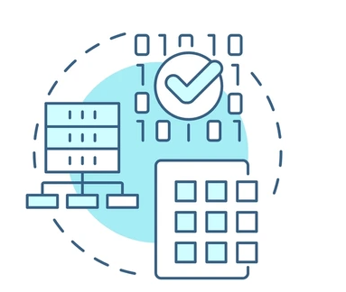
Introduction
to
Data Processing Programming
Lecturer: Shakhnoza Muksimova
Email: shakhnoza02@gachon.ac.kr

Slide 2

Lectures:
We meet at 10:00 am every Thursday on floor 2, room 209.
Read the syllabus and policies carefully.
Reading assignments and lab materials will be posted online.

Slide 3
Grading(tentative):
Report 25%
Attendance
10%
Midterm Exam
10%
Group Project
25%
Final Exam
30%
Those who miss 3 classes will be awarded an F.
Homework and Programming projects will be posted online on the class webpage.

Slide 4



Copy from the Internet
Use ChatGPT.
Copy from your friends

Slide 5
Self-Introduction:
What is your name?
Why did you choose this course?
What computer languages do you know?
What are your expectations for this course?

Slide 6
Course Objectives
Understand the fundamentals of data processing
1
Learn how to implement data processing using programming
2
Apply techniques for cleaning, transforming, and analyzing real-world data
3

Slide 7
Why Is It Important?
Over 2.5 quintillion bytes of data are generated every day
Critical for AI, Big Data, IoT, and analytics
Key to business decisions, research, healthcare, finance, and transportation

Slide 8
What Will You Learn in This Course?
Python for data processing
Libraries: pandas, numpy, matplotlib
Data Cleaning, Transformation, and Aggregation
Introduction to Big Data tools: Spark, Hadoop
Real-world projects: Visualization, Analysis, Reporting

